Slide 1
A Brief Review on “Gait Recognition”Technology
Md Abid Afnan (C211051)
Saeed Bin Jadid (C211042)
Alauddin Mollah (C211055)
Abdullah Al Mamun (C201004)

Slide 2
What is Gait Recognition?
Gait recognition is a behavioral biometric that uses video of a person's walking style and pace to identify them.
It's a type of passive biometric data acquisition that can be used from a distance.

Slide 3
Types of Gait Recognition-
Handcrafted : Handcrafted methods involve manual extraction of pre-defined features from gait data
Deep Learning: deep learning methods encode intricate features automatically, without any human intervention.

Slide 4
HOW DOES GAIT RECOGNITION WORK?
The most common gait recognition system is based on four components:
Capturing Gait data
Silhouette segmentation
Contour detection
Feature extraction and classification.

Slide 5
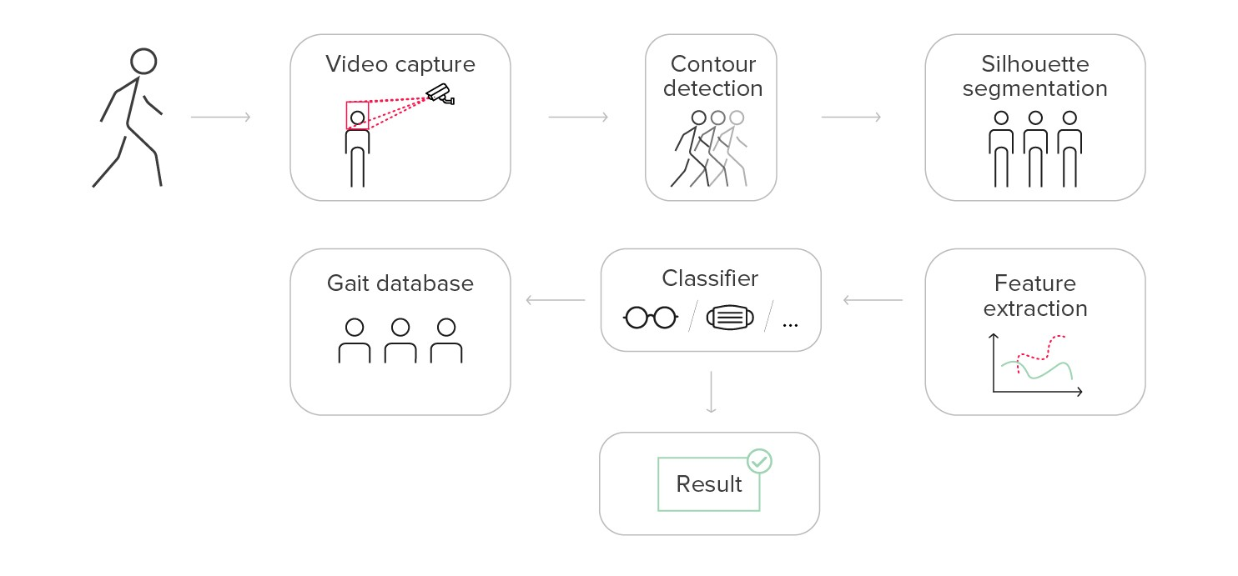
Visual Representation on how “Gait Recognition” Works

Slide 6
Gait Recognition Via Deep Learning Algorithm
Gait recognition with deep learning leverages the power of artificial neural networks,
Specifically Convolutional Neural Networks (CNNs), to automatically identify individuals based on their walking patterns.

Slide 7
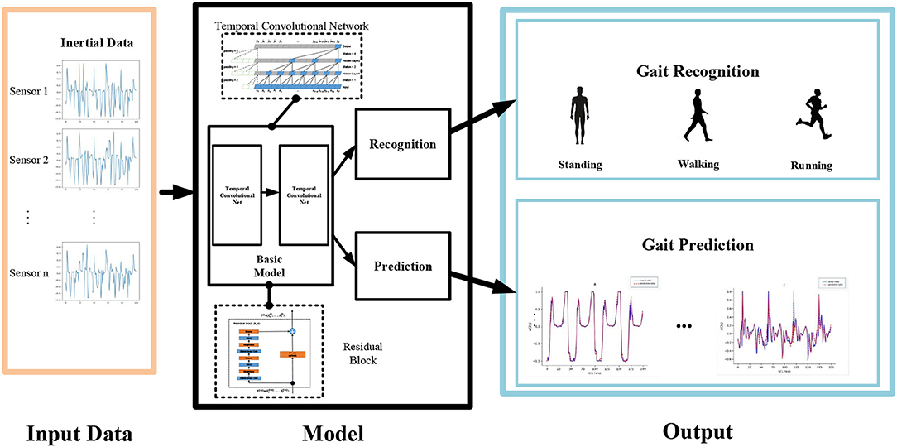
Visual Representation on how “Gait Recognition” Works with Deep Learning (CNN)

Slide 8
Thank you
Md Abid Afnan
Saeed Bin Jadid
Abdullah Al Mamun
Alauddin Mollah

